Slide 1

With a focus on Nexis Data+
Big Data Project Report:
This report provides a comprehensive overview of LexisNexis' big data project with a focus on Nexis Data+, exploring its history, business challenges, information value chain, architecture, data products, and revenue model. It also analyzes the company's success factors and offers recommendations for future growth.
Group 10 -
Meera Palanivel
Niyati Mudliar
Abhishu Tailor
Praveena Venu
Nithin Thomas
Sasi Kumar
Aravind Chintalapudi
Praveen Kumar Singh Jadon

Slide 2

LexisNexis: A Big Data Powerhouse
LexisNexis, a name synonymous with legal and business information, stands as a testament to the power of big data. Founded in 1970, the company has evolved from a provider of legal documents to a global leader in data analytics. This report delves into the intricate workings of LexisNexis, exploring its business model, technical infrastructure, and the value it delivers through its data-driven products.

Slide 3

A Legacy of Information
1
1970s: The Genesis
LexisNexis emerges as a pioneer, offering groundbreaking full-text legal document access, transforming legal research.
2
1990s: Technological Integration
The company embraces technological advancements, integrating digital databases and online platforms, expanding its reach and services.
3
2000s: Data Analytics Pioneer
LexisNexis ventures into data analytics, developing sophisticated tools to extract insights from vast datasets, solidifying its leadership in the field.

Slide 4
Navigating the Data Landscape: Challenges and Opportunities
Business Challenges
Technical Challenges
Expand affordable subscription models.
Enhance data privacy measures.
Simplify integration with other systems.
Invest in innovation.
Localize content and services.
Boost customer engagement.
Form strategic partnerships.
Strengthen marketing efforts to broaden reach and differentiate.
Maintaining data quality.
Overcoming data silos.
Enabling real-time processing.
Designing flexible and effective data architecture.
Ensuring System interoperability.
Managing the complexity of data management tools.
Optimizing performance.
Efficiently processing big data.
Integrating machine learning and AI.
Creating clear data visualization.
Solutions require advanced technology, robust processes, skilled personnel.

Slide 5





Data to Intelligence: The LexisNexis Value Chain
Data Collection
Gathering raw data from diverse sources, including legal documents, news articles, regulatory filings, and social media.
Data Processing
Employing techniques like Natural Language Processing (NLP), machine learning, and data mining to transform raw data into structured formats and extract meaningful patterns.
Information Generation
Creating organized and indexed legal documents, annotated news articles, and comprehensive legal databases accessible through intuitive search and query interfaces.
Insights Unveiled
Utilizing advanced search algorithms, predictive analytics, and trend analysis tools to provide deeper insights into legal and business trends.
Actionable Intelligence
Delivering actionable intelligence for legal decisions, risk management, and regulatory compliance through customizable dashboards, reports, and summaries.

Slide 6
Information Architecture: A Blueprint for Data Transformation
Data Acquisition Zone
Data Processing Zone
Data Storage Zone
Ingesting raw data from various sources using web crawlers, APIs, and ETL tools.
Cleaning, normalizing, and transforming data using the Hadoop ecosystem, Spark, and NLP tools.
Storing processed data for easy retrieval and analysis in NoSQL and relational databases.
Data Analytics Zone
Data Presentation Zone
Performing advanced analytics and machine learning using ML frameworks and BI tools.
Visualizing and presenting insights through dashboards, reporting tools, and user interfaces.

Slide 7
Powering Insights: Data Products and Technical Components
Flagship Data Products
Technical Backbone
Lexis Advance: A comprehensive legal research tool.
Hadoop/Spark: For large-scale data processing.
LexisNexis Newsdesk: A media monitoring and analytics platform.
NoSQL Databases: For scalable and flexible data storage.
LexisNexis Risk Solutions: A suite of risk management tools.
Nexis Data+
NLP and ML Frameworks: For extracting insights from unstructured data.

Slide 8





Nexis® Data+ connects you to an expanding data universe growing by nearly 4M documents a day
Nexis® Data+ solve problems, streamlining delivery of dynamically enriched data so you can begin uncovering actionable insights, sooner. With flexible options to tailor and scale data integrations to fit your unique needs, Nexis Data+ connects you to an expanding data universe — growing by nearly 4M documents a day — all from a single provider.

Slide 9

Source of data for Nexis Data+
Nexis Data+ offers access to legal entity data covering 165 million companies and 220 million executives in 130 countries.
The list of data providers include:
Best’s Company Reports
Bundesanzeiger Verlag
Credit Safe
FBR Asian Company Profiles
GlobalData Ltd.
Handshakes Capital Markets Data
Hoover’s, Inc.
IHS Shipping Data
Infocredit Group Business Information Reports
Integra Industry Reports
LexisNexis® Corporate Affiliations™
London Stock Exchange
SGA Executive Tracker
Vickers Securities Report
Worldbox AG
Worldscope International Company Profiles
Zack’s Equity Research

Slide 10

Types of datasets provided by Nexis Data+
1. BIOGRAPHICAL DATA
Features biographical data aggregated from 150+ biographical sources, giving you insights into personal information, career histories, educational backgrounds, credentials, and more.
PURPOSE:
Insights helpful for making major hiring decision or evaluating a potential merger or acquisition and sales prospects identification:
Validation of backgrounds of top officers, board members or other influential players to understand potential risks
Facilitates expansion of your sales efforts
Helping to find potential buyers as well as avoid conflicts of interest sooner.
The dataset features information from:
Gale Biographies
SGA Executive Tracker
Professional Contacts
The Complete Marquis Who’s Who® Biographies
The Official Board Biographies
Salutary
Morningstar, Inc. U.S. Executive Compensation Database
Executive Biographies from MorningStar, Inc.

Slide 11

Types of datasets provided by Nexis Data+
2. LEGAL DATA
Features a dataset spanning more than 50,000 legal intelligence sources, ranging from legal news, law reviews and journals to decided court cases from state, federal and international courts, covering the United States, Canada, England, Wales, Ireland, Northern Ireland, Scotland, European Union, Malaysia, Brunei, Hong Kong, Australia, New Zealand and South Africa.
PURPOSE:
Insights helpful for ingesting legal data into your intelligence applications :
Helps you stay alert to decisions, enforcement actions, or rulings that could impact your business
Improved visibility into emerging regulatory or legal trends
Organizational as well as third party risk mitigation
Warning bell analytics from litigious history or current legal entanglements
Other types of legal data available includes:
Agency Decisions
Expert Witness Materials
Statutes & Legislation
Jury, Verdicts & Settlements

Slide 12

Types of datasets provided by Nexis Data+
3. INTELLECTUAL PROPERTY DATA
Access key trademark information including names, registration details, and expiration dates, and decode vital copyright aspects like ownership and registration. In addition to aggregated data from 100+ IP news titles, Nexis Data+ typically captures 55,000+ trademarks a month, expanding on the 37M+ copyrights and 30M+ trademarks already included in the dataset.
PURPOSE:
Leveraging detailed trademark and copyright data significantly enhances R&D and product development
Helps in safeguarding the intellectual property rights
Information useful for strategic decisions & competitive edge
Data collected from :
Global IP News
US Copyright and Trademarks
International Trademarks

Slide 13

Types of datasets provided by Nexis Data+
4. RISK & COMPLIANCE DATA
Features datasets aligned with best practice for third-party risk management and regulatory compliance, such as 1.5 million profiles of politically exposed persons (PEPs), their family members, and close associates from 240 countries or territories. In addition, available data covers 1,400+ sources of domestic and global sanctions, watch lists and blacklists ranging from white collar crimes to crimes against humanity.
PURPOSE:
Helps you establish agile, proactive strategies that align with regulators’ and stakeholders’ expectations.
Enriched visibility that supports risk-based due diligence and compliance with other international regulatory standards.
Using historical analysis to spot red flags related to potential partners or transactions or pattern identification to reveal emerging regulatory trends.
Examples of lists from where the data is collected:
International Police Most Wanted and Red Alerts
Office of Controller of Currency—Unauthorized Banks List
State Department Terrorist Exclusion List
OFAC—Specially Designated Nationals (SDN) List; Non-SDN List, including Palestinian Legislative Council; Enhanced Sanctioned Countries List
U.S. Bureau of Industry and Security—Denied Persons List;
Unverified List; Entity List

Slide 14
Data Models: The Four Pillars of LexisNexis
1
Data Acquisition
2
Data Storage
Prioritizing diverse data sources, continuous data ingestion, and robust updating mechanisms to ensure data relevance and accuracy.
Implementing hybrid storage solutions that combine relational and non-relational databases for optimal performance and flexibility.
3
Data Processing
4
Data Presentation
Utilizing distributed processing frameworks and advanced techniques to ensure data quality and consistency.
Focusing on user-friendly interfaces, customizable dashboards, and real-time data visualization to facilitate effective data interaction and insight generation.

Slide 15
The Business of Data: Revenue Model and Success Factors
Business Model
Revenue Streams
Success Factors
Subscription-based access to databases
Subscriptions from individual and corporate users
Comprehensive data coverage
Licensing of data and API access
Licensing fees from businesses
Advanced analytics capabilities
Provision of custom data solutions and consulting
Revenue from tailored services
Strong market trust and reputation

Slide 16
Analyzing Success: Strengths, Weaknesses, and Recommendations
Strengths
Weaknesses
Recommendations
Comprehensive databases.
Advanced AI and machine learning.
Trusted brand.
Global reach.
User-friendly platforms.
Diverse clientele.
Maintains leaderships in the data and analytics industry.
High subscription costs.
Dependency on subscription revenue.
Data privacy and management challenges.
Integration complexities with other systems.
Intense competition from various data providers.
Market position pressures despite established presence.
Expand affordable subscription options.
Enhance data privacy measures.
Simplify integration with other systems.
Invest in innovation initiatives.
Localize content and services.
Boost customer engagement strategies.
Form strategic partnerships.
Strengthen marketing efforts.

Slide 17
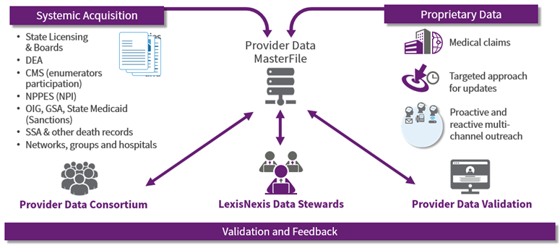
Data Acquisition: The Foundation of LexisNexis
LexisNexis understands that the lifeblood of its business is data. The company employs a multi-faceted approach to data acquisition, ensuring a constant flow of fresh, relevant information.

Slide 18
Diverse Sources: Casting a Wide Net for Information
LexisNexis sources its data from a wide array of sources including:
Legal Documents
News Articles
Regulatory Filing
Social Media
This diverse approach ensures a comprehensive view of the legal and business landscape.

Slide 19
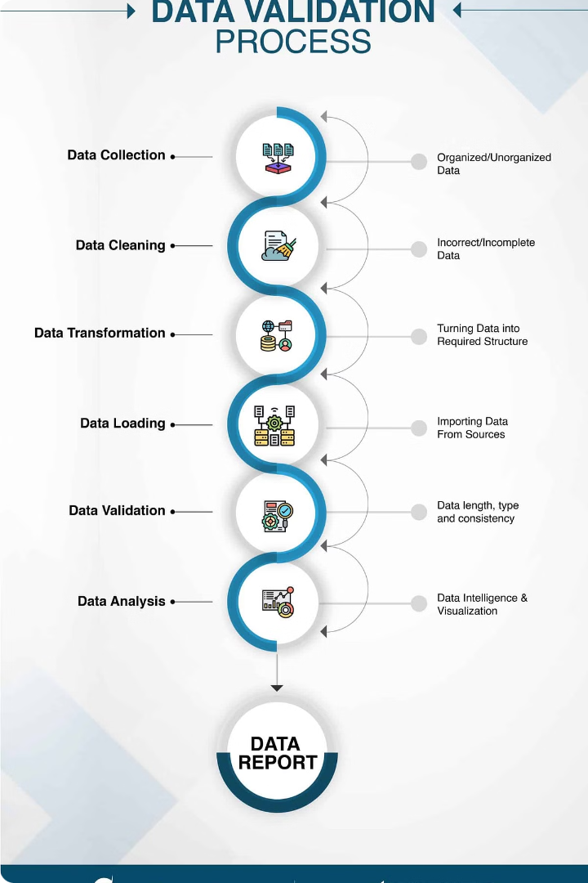
Robust Updating Mechanisms: Maintaining Data Accuracy
Data accuracy is paramount for LexisNexis. The company has implemented robust updating mechanisms to ensure that its data is accurate and reliable. These mechanisms include automated checks and balances, as well as manual review processes.

Slide 20
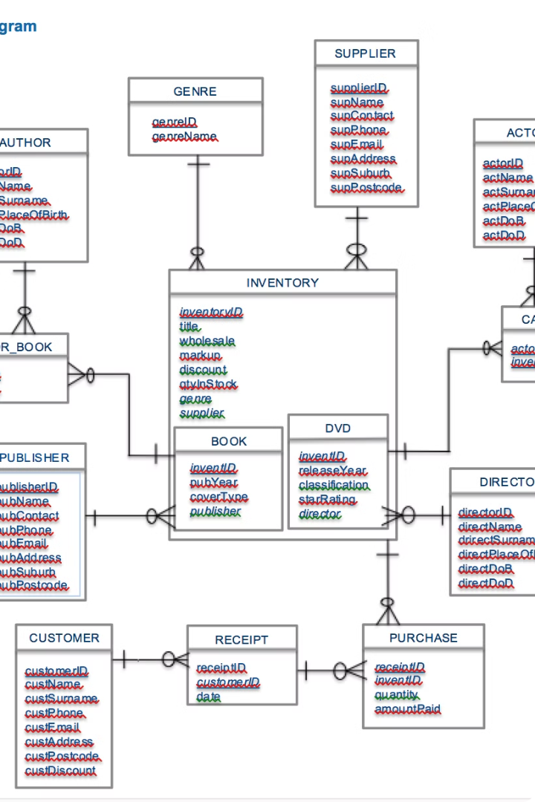
Relational Databases: Structured Data Management
Relational databases are well-suited for storing structured data, such as legal cases and contracts. LexisNexis leverages relational databases to ensure data integrity and consistency.

Slide 21
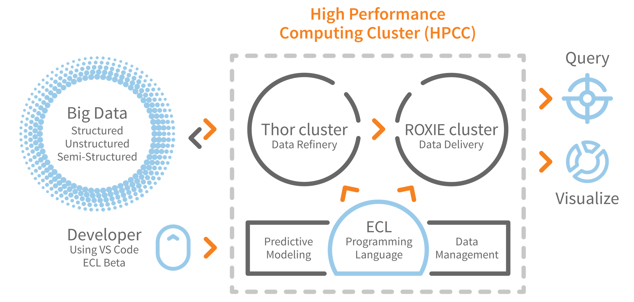
Data Processing: Transforming Raw Data into Insights
Data processing is at the heart of LexisNexis's ability to deliver valuable insights. The company employs a range of techniques, including distributed processing frameworks and advanced algorithms.

Slide 22
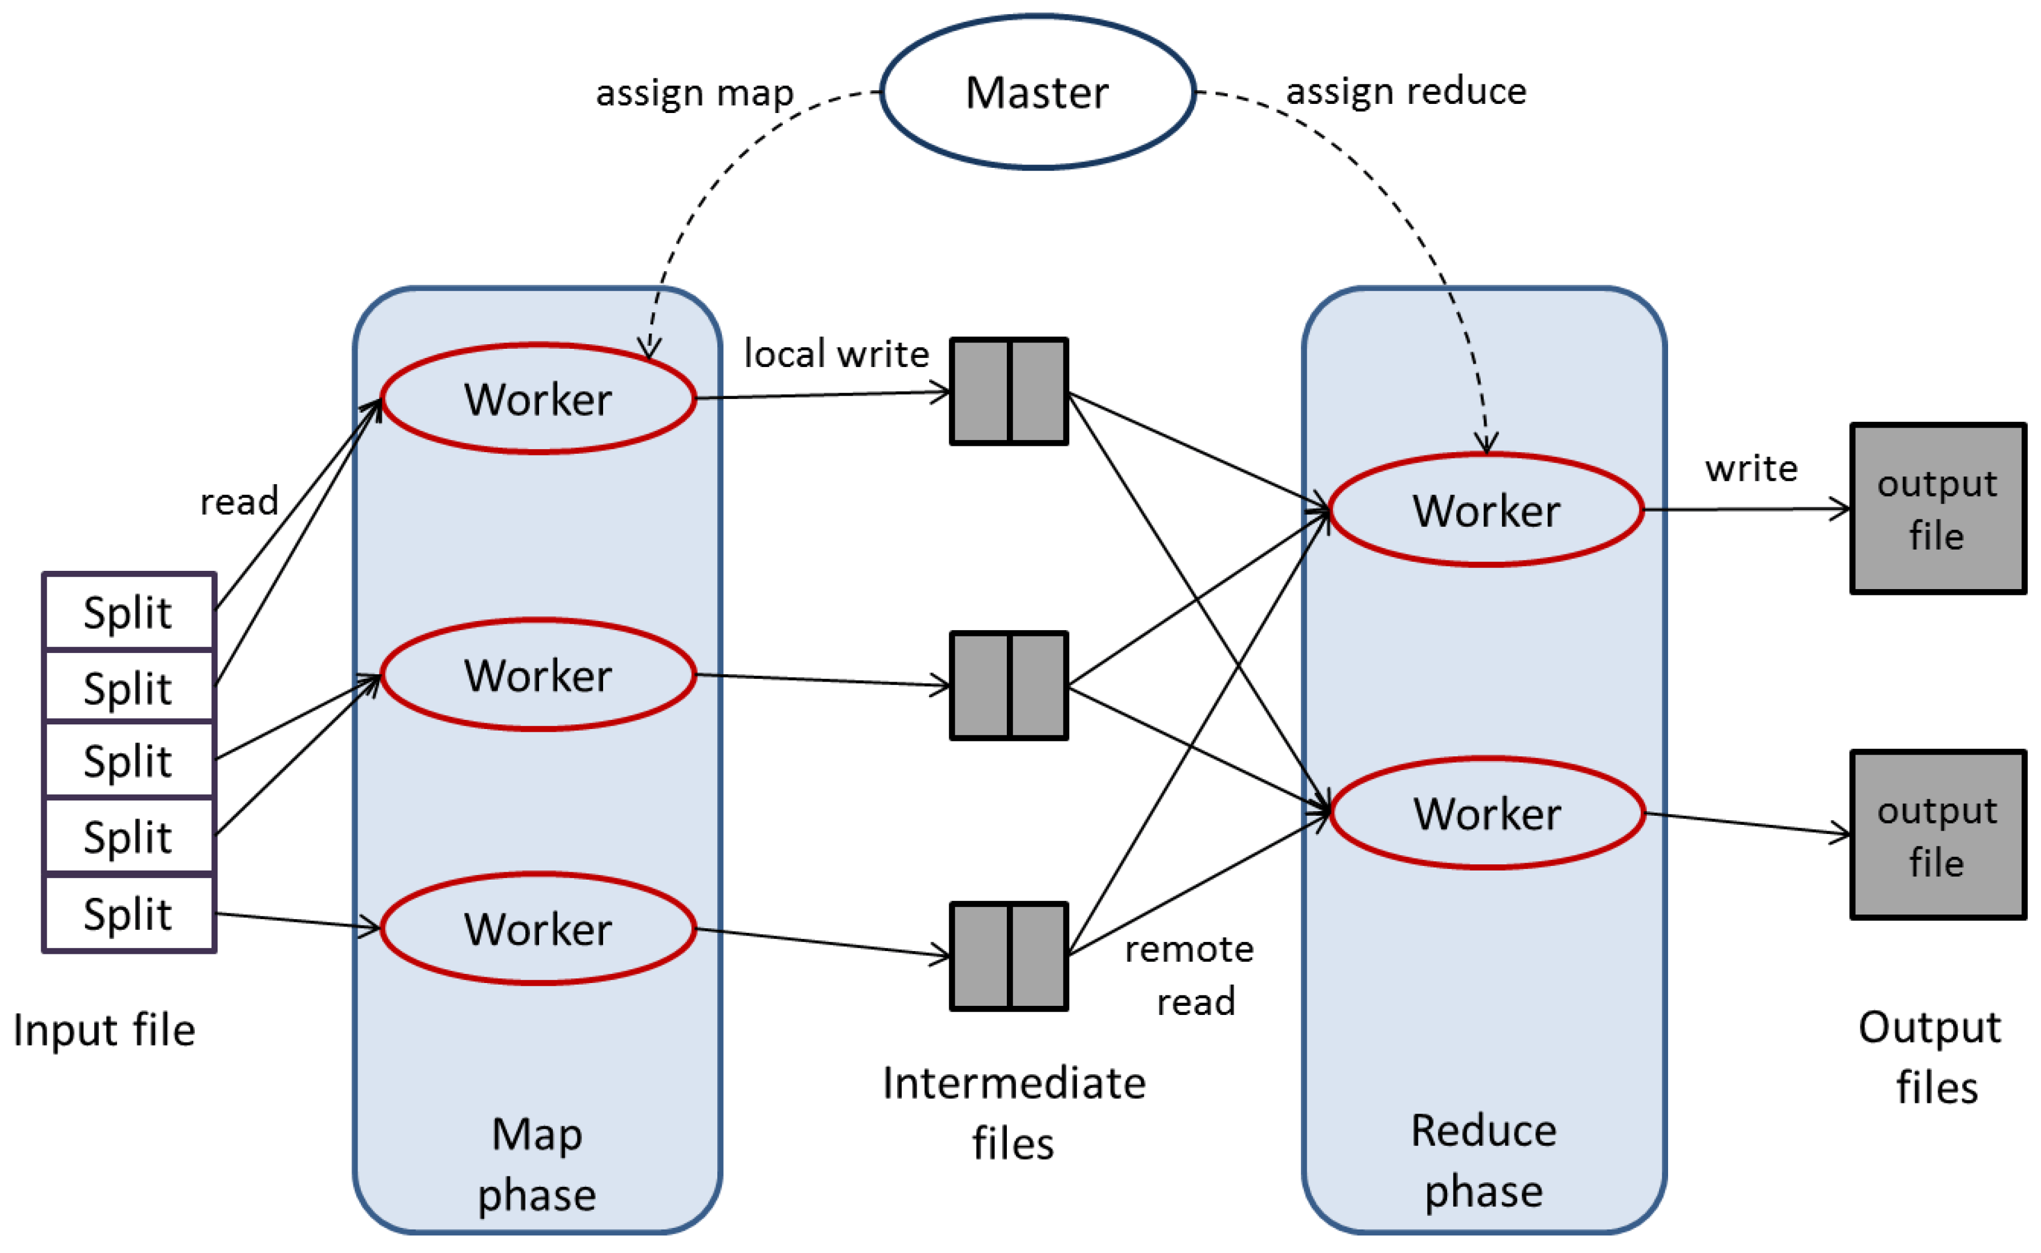
Distributed Processing: Handling Massive Datasets
To process its massive datasets efficiently, LexisNexis leverages distributed processing frameworks like Hadoop and Spark. These frameworks allow for the distribution of data processing tasks across multiple nodes, significantly reducing processing time.

Slide 23
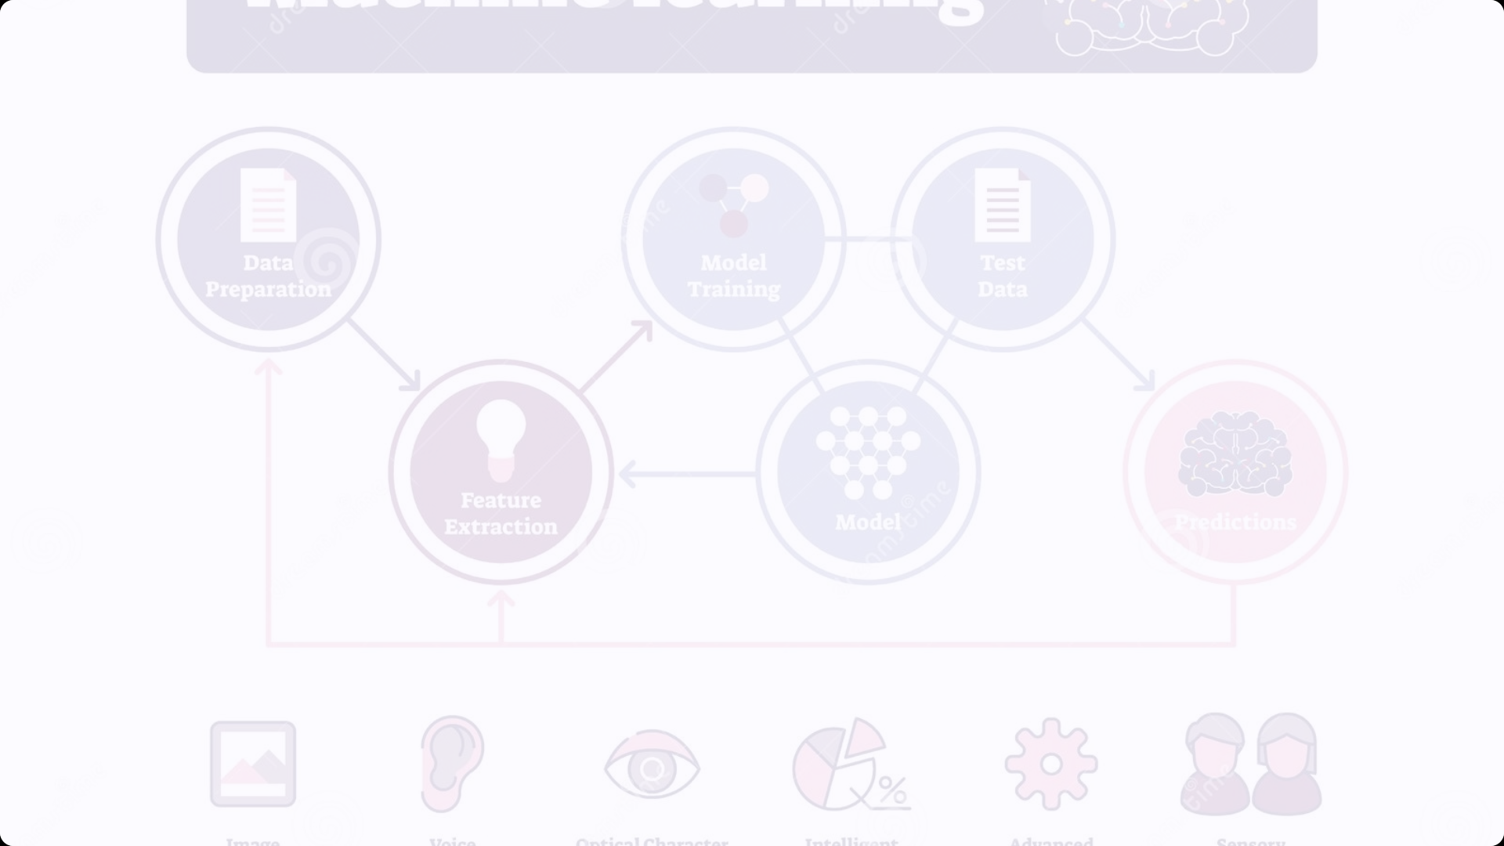
Advanced Algorithms: Extracting Meaning from Data
LexisNexis employs advanced algorithms, including natural language processing (NLP) and machine learning (ML), to extract meaningful insights from its data. These algorithms enable the company to identify patterns, trends, and anomalies that would be difficult or impossible to detect manually.

Slide 24
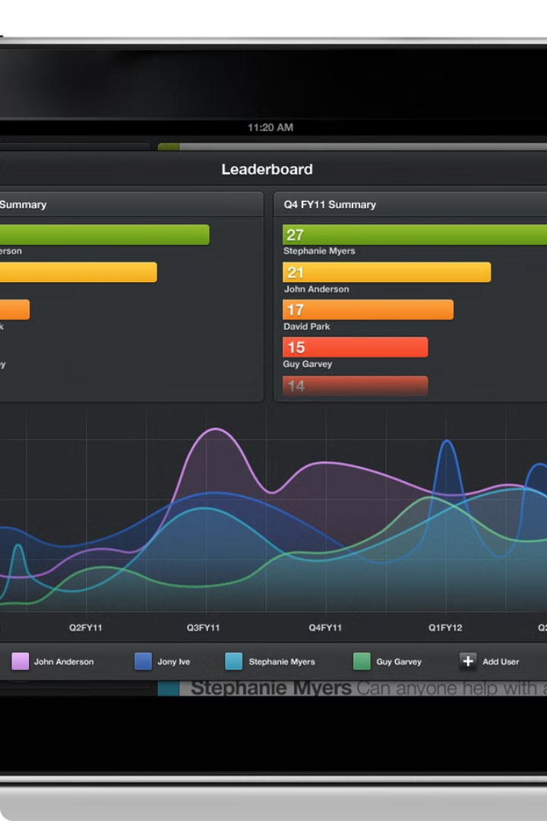
Data Presentation: Making Insights Accessible
LexisNexis understands that data is only as valuable as its ability to be understood and acted upon. The company places a strong emphasis on data presentation, providing users with intuitive tools and visualizations.

Slide 25
Real-Time Data Visualization: Enabling Timely Decision-Making
In many cases, timely decision-making is critical. LexisNexis provides real-time data visualization tools, allowing users to track trends, identify anomalies, and make informed decisions based on the most up-to-date information.

Slide 26

The Future of LexisNexis: Continued Innovation in the Data Age
As a leader in the data analytics space, LexisNexis is committed to continuous innovation. The company is constantly exploring new technologies and approaches to further enhance its data processing, analysis, and presentation capabilities.

Slide 27
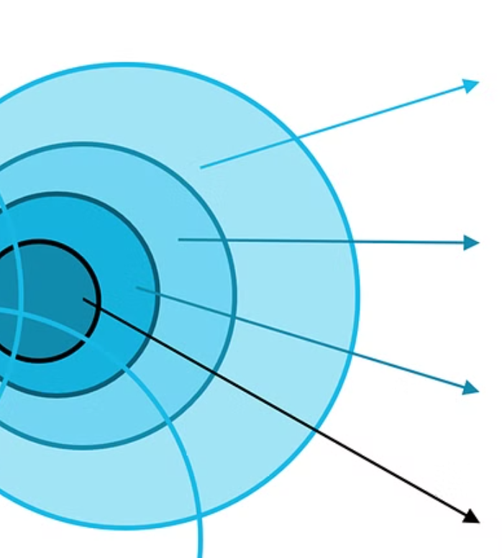
Artificial Intelligence and Machine Learning: Expanding Analytical Horizons
LexisNexis recognizes the transformative potential of artificial intelligence (AI) and machine learning (ML). The company is investing heavily in these technologies to develop even more sophisticated analytical tools and deliver deeper insights to its users.

Slide 28
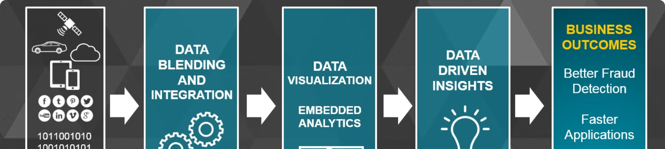
New Markets and Industries: Expanding the Reach of Data-Driven Insights
While LexisNexis has traditionally focused on the legal and business sectors, the company is increasingly exploring opportunities in new markets and industries. The company's data analytics expertise has applications in a wide range of fields, including healthcare, finance, and government.

Slide 29
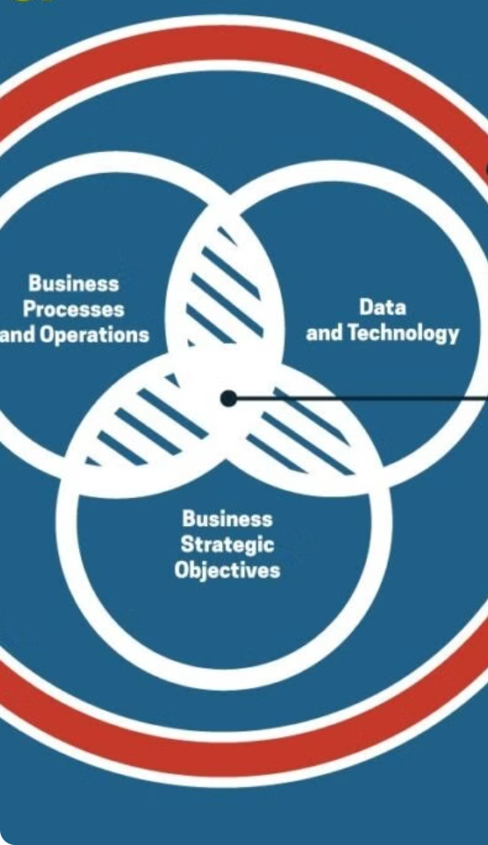
Data as a Strategic Asset: Empowering Businesses and Professionals
LexisNexis views data as a strategic asset, one that can empower businesses and professionals to make better decisions, mitigate risks, and achieve their goals. The company is committed to providing its users with the tools and insights they need to succeed in the data-driven world.

Slide 30
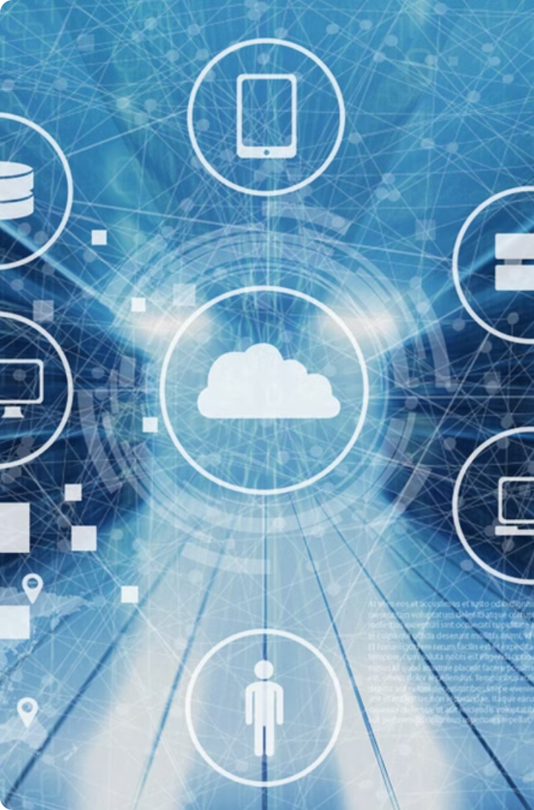
Conclusion: LexisNexis - A Data Pioneer Shaping the Future
From its humble beginnings as a provider of legal documents, LexisNexis has evolved into a global data powerhouse. The company's unwavering commitment to data quality, technological innovation, and user-centric design has positioned it as a leader in the data analytics space. As the world becomes increasingly data-driven, LexisNexis is well-positioned to continue shaping the future of how we access, analyze, and utilize information.

Slide 31

Sources
- LexisNexis Company Profile. Retrieved from LexisNexis website: https://www.lexisnexis.com/en-us/about-us/company-profile.page
- "LexisNexis: The Business of Law." Harvard Business Review. Retrieved from HBR website: https://hbr.org
- Gartner Analysis on LexisNexis Solutions. Retrieved from Gartner: https://www.gartner.com
- Crunchbase Profile for Lexis

